Slide 1

Augmented Reality in Furniture placement
Group No. 8
Tejas Khanted - 17104015
Aniket Gaikwad - 17104032
Kavan Naik - 17104006
Project Guide – Prof.Kaushiki Upadhyaya
Co-guide – Prof.Nahid Shaikh

Slide 2
Contents
Introduction
Objectives
Problem Definition
Technological Stack
Review Suggestions
Proposed System Architecture/Working
Prototype Design Demonstration
Plan of Paper Publication

Slide 3
1.Introduction
  Augmented reality is a technology within which we can see the objects in physical world virtually, thus providing a composite view. It gathers a wide variety of user experiences.
  We are going to develop a system with augmented reality that lets user to try on virtual furniture in user’s real home structure before buying. From this user will be able to choose furniture objects a lot easier.
  By using this application, it will be convenient for the user to choose furniture items. This will additionally help the user to try out the furniture items in their room and they will be able to see how it will look after placing furniture in it.
  User can attempt multiple combination of furniture objects virtually without physically moving the furniture items. Our motivation here is to increase the time efficiency and additionally improve the accessibility of furniture try on by making this layout in augmented reality.

Slide 4
2.Objectives
  The main objective of Augmented reality in furniture placement are:
  • To create a mobile based application for furniture placement using augmented reality technology.
  • By this app user can visual furniture at they are own spaces and it will help them to buy the best furniture.
  • To develop an augmented reality mobile application in furniture placement which is more convenient to the user.
  • To produce realistic virtual furniture model in mobile app similar to the real furniture.

Slide 5
3.Problem Defination
  As more and more purchases move online, new categories of products start gaining ecommerce traction. Using AR people can visualize the required furniture and make a perfect choice in between them so, making it easier rather than actually taking a note of dimensions, look and color or physically bringing of the furniture for making choice.
  The biggest problem with buying furniture is that you have almost no idea how it will actually look into your interior. This is why people hire visual designers who can show the whole picture. With an AR app you’ll be able to place any piece of furniture into your apartment without needing to bring it there physically. As augmented reality application that allows you to do that. It can even scale the furniture and change colors, so you can choose that perfect sofa for your living room.

Slide 6
4.Technological stack
  Unity 3d
  AR foundation with AR Core
  Supported Mobile Devices/Minimum system Requirements
AR Required" apps must declare minSdkVersion ≥ 24 (API Level 24, Nougat, version7.0)
https://developers.google.com/ar/discover/supported-devices

Slide 7
5.Review Suggestions
Improvement in Scalability of the product
- inclusion of dynamic models
- Storage on Cloud.
Improvement in Security of product.
- Authentication of user via sign up
- Once the cloud storage is done we will include more feature of security.

Slide 8
6.Proposed System Architecture/Working
  Product Functions
  User can animator slide for selecting objects for virtual placements
  Marker less object placement
  Multiple textures for single object
  Furniture can be Rotated, Resized.
  Can import your own model
  Multiple Color for Furniture
  Operating Environment -The AR system is a mobile based application which can be used on Android mobile operating system.

Slide 9
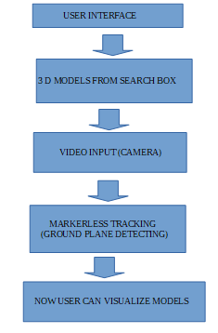
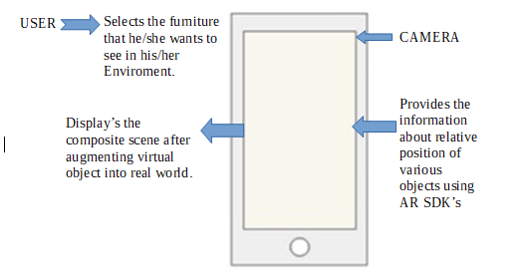
System Architecture Diagram

Slide 10
Working:
Markerless: Markerless Augmented Reality is used to denote an AR application that doesn't need prior knowledge of a user's environment to overlay 3D content into a scene and hold it to a fixed point in space. Augmented Reality has completed the transition from image- or QR code-based activations to markerless Augmented Reality experiences.
Animator Slider : User will able to find variety of furniture in app and can visualize in AR system.
Multiple texture for furniture: User will able to visualize variety of texture and color. So that user can find perfect texture.
Importing your own Models:. User can ask developer to create model his/her required furniture model
Furniture Description: Virtually user can find out description of furniture as, size,material used, texture, color.

Slide 11
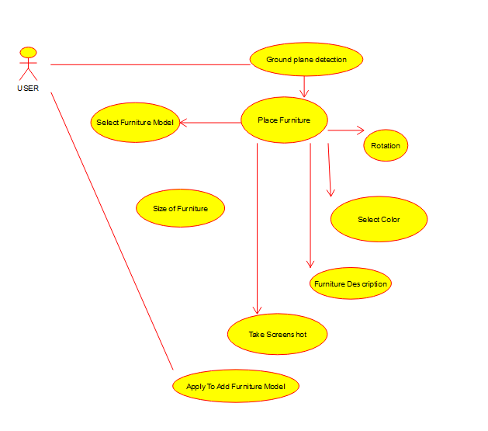
To save Visual Screen- User can save the visual screen by taking the screenshot option.
Rotation, resizing :User can rotation, resizing the furniture on screen to that visual the furniture according to their need.
Use Case Diagram

Slide 12
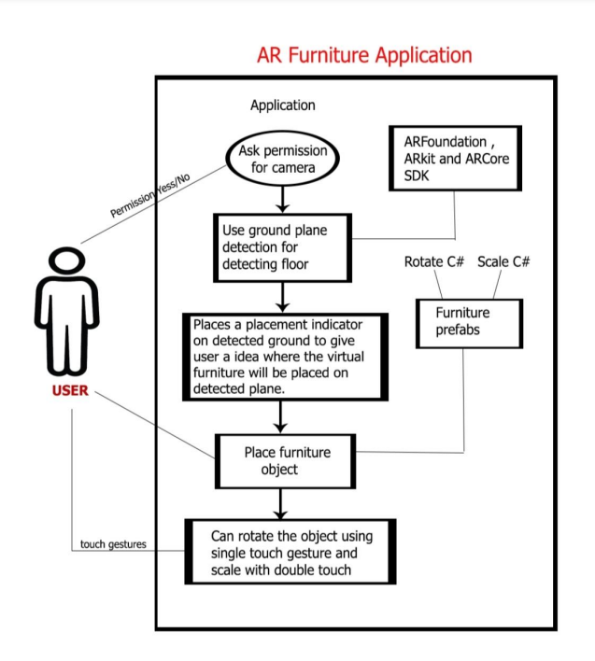
7.Prototype Design Demonstration
Use Case Diagram

Slide 13
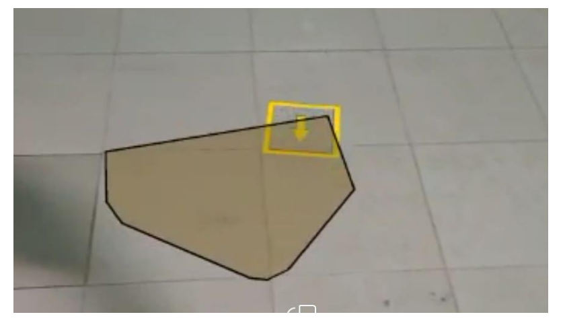
Detecting Ground Plane:

Slide 14
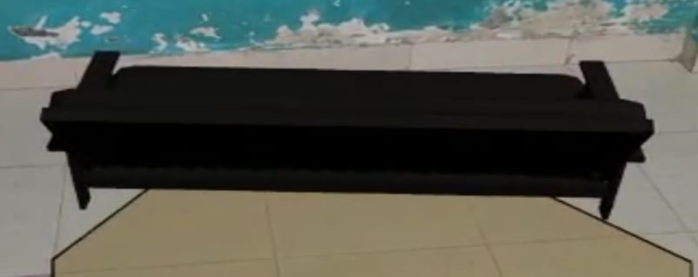
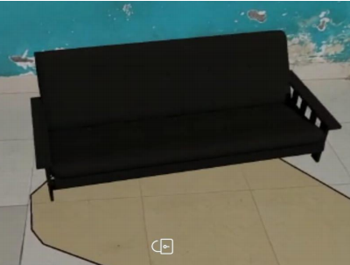
Rotating
Object :
Resizing Object:

Slide 15
8.Plan of Paper Publication
We are planning to present a paper in IEEE 2021 6th International Conference for Convergence in Technology.
The Full paper deadline for this conference is 15th Nov 2020.
We are currently doing literature review.

Slide 16
Thank You...!!

